Slide 1
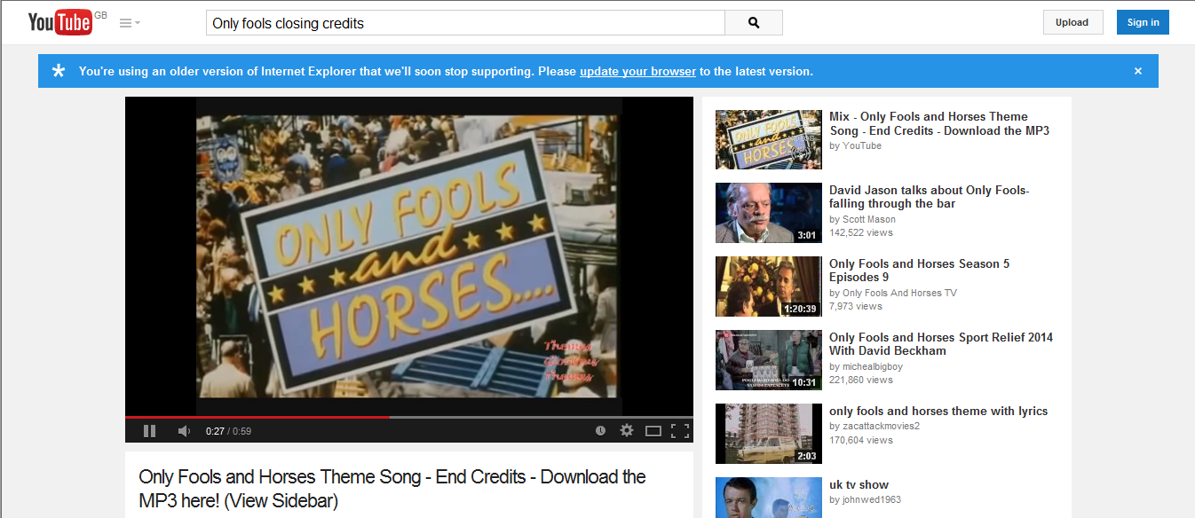
Listen to this clip
https://www.youtube.com/watch?v=uxOEhc960Bc

Slide 2
Design your own lesson objective
“Today we are going to learn about …”
(Complete this sentence)

Slide 3
“Taxes are …”
(Complete this sentence)

Slide 4
“Taxes are a financial charge or other levy imposed upon a individual by the state …”

Slide 5
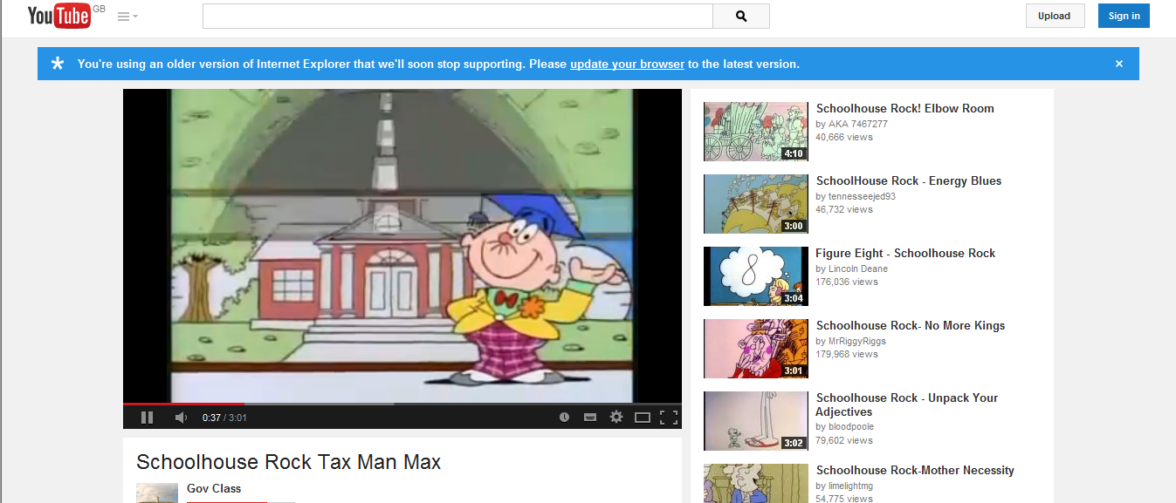
Watch this clip
https://www.youtube.com/watch?v=ZbGMXEdEC6I

Slide 6
Your task
You have 1 minute to name as many things as possible that taxes pay for

Slide 7
What is income tax?
(answer this question)

Slide 8
Income tax is a tax levied by a government directly on income, especially an annual tax on personal income

Slide 9
Income tax rates
1. If you earn between £0 - £31,865 your rate of income tax is 20%
Example
“I am nurse who earns £25,000 per a year how much income tax will I pay?

Slide 10
Income tax rates
1. If you earn between £0 - £31,865 your rate of income tax is 20%
Example and answer
I am nurse who earns £25,000 per a year how much income tax will I pay? =£5000
Working
25000 X 20 = 500000
50000 /100 = 5000

Slide 11
Income tax rates
2. If you earn between £31,866 - £150,000 your rate of income tax is 40%
Example
“I am doctor who earns £80,000 per a year how much income tax will I pay?”

Slide 12
Income tax rates
2. If you earn between £31,866 - £150,000 your rate of income tax is 40%
Example and answer
I am doctor who earns £80,000 per a year how much income tax will I pay?=£32000
Working
80000 X 40 = 3200000
3200000 /100 = 32000

Slide 13
Income tax rates
3. If you earn over £150,000 your rate of income tax is 45%
Example
“I am a footballer who earns £10,000000 per a year how much income tax will I pay?”

Slide 14
Income tax rates
3. If you earn over £150,000 your rate of income tax is 45%
Example and answer
I am a footballer who earns £10,00000 per a year how much income tax will I pay?=£4500000
Working
1000000 X 45 = 45000000
45000000 /100 = 4500000

Slide 15
“What does VAT stand for?”
(Answer this question)

Slide 16
VAT stands for value- added tax

Slide 17
Your task
You have 2 minute to name as many things as possible that you don’t pay VAT on:

Slide 18
Things that you don’t pay VAT on:
Baby and children clothes
Books, newspapers and magazines
donated clothes in charity shops
froozewn foods
cold take away
Medical treatment
Funeral costs
All forms of gambling
Stamps

Slide 19
What is the current VAT rate?
(Answer this question)

Slide 20
The current VAT rate is 20%

Slide 21
VAT in action
You buy a computer game for £55
How much do I pay in VAT?
You buy a Car £5000
How much do I pay in VAT?

Slide 22
VAT in action (answers)
You buy a computer game for £55
how much of this price is VAT? = £11
Working
5500p X 20 = 11000
11000 /100 =1100 = £11
You buy a Car for £5000
How much of this price is VAT? = £1000
Working
500000p X 20 = 11000
10000000 /100 =1000.00 = £1000.00

Slide 23

Discussion Topic
“In the UK to people pay to much tax?”

